Slide 1
Network Stacks
EN.600.444/644
Spring 2019
Dr. Seth James Nielson

Slide 2
What is a Protocol?
A protocol is the set of rules that govern the interaction of two or more parties
In the context of networking, it defines how two nodes communicate
When a party can communicate
What a party can communicate, including message structure
How a party responds to received communications
Certain outcomes or results are guaranteed when the rules are followed

Slide 3
Overloaded Term
Actually, a protocol often refers to two separate things
FIRST, the rules/specification referred to on the previous slide
SECOND, the computer module that implements the rules

Slide 4
Common Contemporary Protocols
HTTP – HyperText Transfer Protocol
IP – Internet Protocol
SMTP – Simple Mail Transport Protocol

Slide 5
One Protocol is not Enough
There are too many rules for any one protocol to handle
Also, behavior/rules need to change for different hardware/goals
For example, consider HTTP
HTTP protocol shouldn’t need to worry about the IP protocol rules
HTTP definitely shouldn’t need to worry about Ethernet rules
And HTTP should work even after a switch from Ethernet to Wifi

Slide 6
Protocol Stacks
Object-oriented design has been around long before object-oriented programming
Modularity
Abstraction
Information hiding
Protocols are designed in an object-oriented fashion
Protocols are combined to solve more complex problems
Each protocol should focus on one purpose/goal (High Cohesion)
Different component protocols can be swapped (Low coupling)
We call a group of protocols that work together a protocol stack
In computer networking, a network protocol stack or a network stack

Slide 7
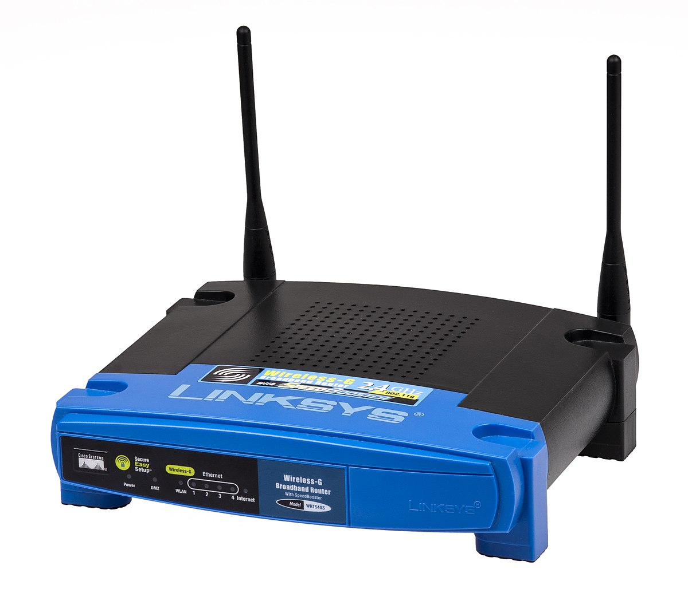

Monolithic vs Modular
HTTP Monolith Ethernet
HTTP Monolith
Wifi
HTTP
TCP
UDP
IP
Ethernet
WiFi
This Photo by Unknown Author is licensed under CC BY-SA
This Photo by Unknown Author is licensed under CC BY-SA

Slide 8
Other Problems with Monolithic
No separation of user/kernel space components
Code cannot be reused; code bloat
NxM combinations
Patching nightmare
Testing limitations
List goes on and on

Slide 9
OSI Model
Good object-oriented design is implementation independent
ISO defined a guide for any given network stack called the OSI Model
It has seven layers:
7: Application
6: Presentation
5: Session
4: Transport
3: Network
2: Data Link
1: Physical

Slide 10
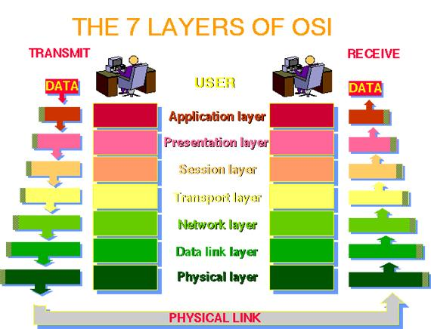

Slide 11
The OSI Model in Practice
Like most OO-designs, the abstraction often breaks down
Many stacks have multiple protocols in “one layer”, and none in another
Modularity/abstraction/information hiding break down
The TCP/IP stack really only uses the following layers:
Application (Layer 7; example: HTTP)
Transport (Layer 4; TCP)
IP (Layer 3; IP)
Data Link (Layer 2; example: Ethernet)
NOTE: It’s common to just refer to a layer by it’s number (e.g., a layer-4 protocol)

Slide 12
TCP/IP Stack
For our purposes, we will focus on TCP/IP and TCP/IP-like stacks
The TCP and IP layers are, obviously, fixed for layers 3 and 4.
But layers 7 and 2 vary widely
Millions of networked applications work over TCP/IP at layer 7
Many layer 2 protocols such as WiFi, Ethernet
Networked applications work over WiFi or Ethernet without any change
Sometimes called a MAC protocol (Media Access Protocol)
TCP/IP work over a walkie-talkie with an appropriate MAC protocol

Slide 13
How does Data Move in a Stack?
To send, data is inserted (pushed) at the top-most protocol
The receiving protocol
Processes the data, potentially splitting, recoding, etc
Derives one or more chunks of data
Typically affixes a header to each, but sometimes a footer and/or other meta-data
Each chunk, along with the meta-data is a “packet”
The packet is inserted (pushed) down to the next layer
When data is received, the process is reversed

Slide 14
TCP/IP Stack Example
HTTP Request
TCP
TCP
HTTP Request
IP
IP
TCP
HTTP Request
MAC
MAC
IP
TCP
HTTP Request

Slide 15
Division of Labor in TCP/IP
At the lowest layer, the MAC protocol simply connects two endpoints. Typically:
Has its own addressing scheme (MAC address)
Controls who talks when
Provides error detection and error correction
IP (Internetwork Protocol)
Connects many different networks of different media types
Global addressing scheme
TCP
Reliable, in-order delivery (Session)
Multiplexing

Slide 16
Interoperability
No one company writes all TCP modules; How do they work together?
Protocol specifications are approved by the IETF (Internet Engineering Task Force)
You can find the specifications in RFC’s (Request For Comments)
RFC 793 was the first specification of TCP (1981)
So long as an implementation follows the spec, it will be interoperable

Slide 17
RFC 793 Overview
Data broken into “segments” in section 2.2
Network layers in section 2.5 (a little different from our usage)
Section 2.6 lays out critical goal: Reliability
Data is delivered reliably (i.e., delivery is assured)
Data is delivered in-order
How? Sequence numbers and acknowledgements on segments
Section 2.7 identifies another goal: Multiplexing
Different flows get different ports
Section 2.8 indicates that this is a stream based protocol

Slide 18
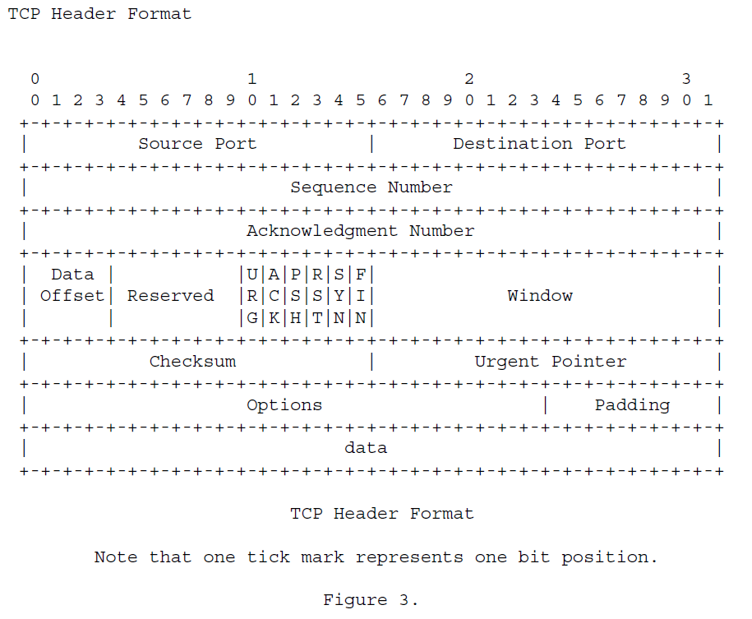

Slide 19
Protocols and State Machines
It is often useful to model a protocol as a finite state machine (FSM)
The protocol starts in an initial state
When it receives data, it processes the data and moves to a new state
For TCP, a state machine is defined in section 3.2
If you don’t know what a FSM is, or how it works, you should probably look it up

Slide 20
Playground Networking
In Playground, we also have a network stack:
Application Layer (e.g., Escape Room, Bank)
Playground Wire Protocol (Layer2/3)
TPC/IP as our Mac Protocol
NOTE: This is important! TCP/IP, for our overlay network, is just a “wire”

Slide 21
Escape Room
(client)
Escape Room
(server)
Playground Wire Protocol
Playground Wire Protocol
TCP/IP “Wire”

Slide 22
Playground Networking Pt 2
Notice we don’t have a layer 4 (session)
Packets transmitted using the playground wire protocol are not connected together
It’s just luck (!!!!) that certain applications “appear” to work right
And, once we turn on packet loss, there’s no guarantee anymore!
You will DESIGN and IMPLEMENT a transport protocol for Playground.

Slide 23
Escape Room
(client)
Escape Room
(server)
Class Transport Protocol
Class Transport Protocol
Playground Wire Protocol
Playground Wire Protocol
TCP/IP “Wire”

Slide 24
PRFC
Every group will create a PRFC to describe your protocol (Playground RFC)
It needs to define the protocol clearly enough that anyone in the class can implement it!
The PETF will review all team submissions and vote for the one the class will use
In creating the protocol, you need to define your packet structure.

Slide 25
REMEMBER THIS?

Slide 26
Packet Definition
WE ARE NOT GOING TO DEFINE PACKETS AT THE BIT/BYTE LEVEL
To make this easier, Playground provides a simple method for defining, creating, and processing packets
You start by defining a packet structure using the PacketType class
from playground.network.packet.fieldtypes import UINT32, STRING
from playground.network.packet import PacketType
class MyPacket(PacketType):
DEFINITION_IDENTIFIER = “netsec.20191.MyPacket”
DEFINITION_VERSION = “1.0”
BODY = [ (“src”, STRING),
(“port”, UINT32) ]

Slide 27

PacketType And PRFC
Do NOT put byte descriptions in your PRFC for your packet definitions
Instead, put in the playground packet type class definition!
from playground.network.packet.fieldtypes import UINT32, STRING
from playground.network.packet import PacketType
class MyPacket(PacketType):
DEFINITION_IDENTIFIER = “netsec.20191.MyPacket”
DEFINITION_VERSION = “1.0”
BODY = [ (“src”, STRING),
(“port”, UINT32) ]
This Photo by Unknown Author is licensed under CC BY-SA

Slide 28
The Packet Definitions Define a Standard
But they are also practical and useful:
packet = MyPacket()
packet.src = “20164.1.2.3”
packet.port = 80
transport.write(packet.__serialize__())

Slide 29
Deserializing Packets
def __init__(self):
self._buffer = MyPacket.Deserializer()
def recv(self, data):
self._buffer.update(data)
for pkt in self._buffer.nextPackets():
print(pkt.src)
print(pkt.port)

